Slide 1
How To Enroll in RMI Training Classes

Slide 2
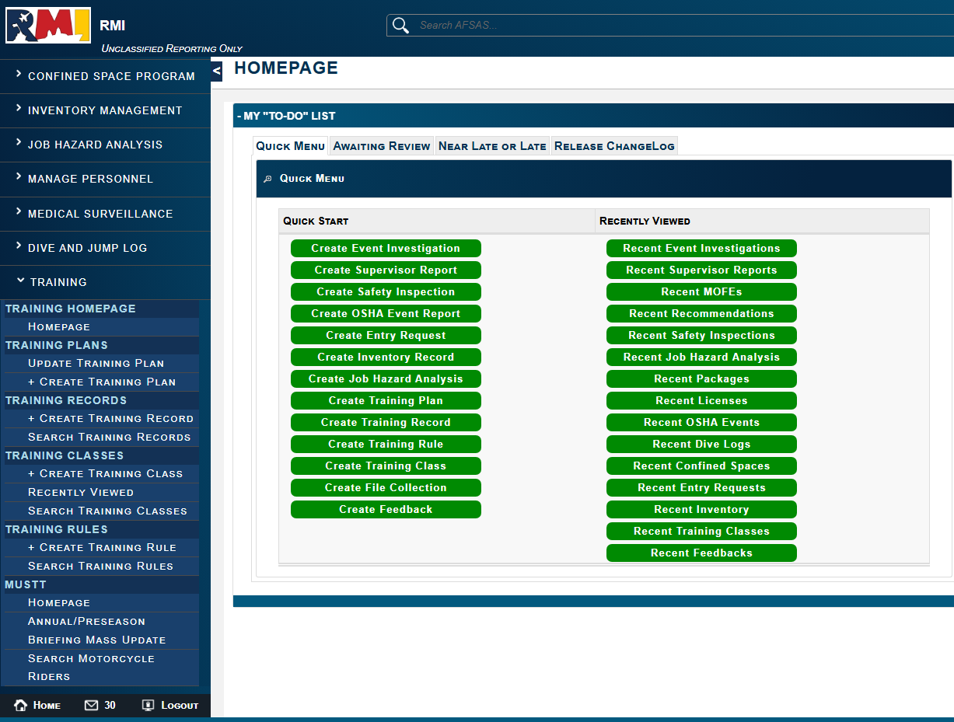
You must have an RMI account to enroll in one of the MCI-West Safety Classes
Select the “Training” module
and click “Search Training
Classes”

Slide 3
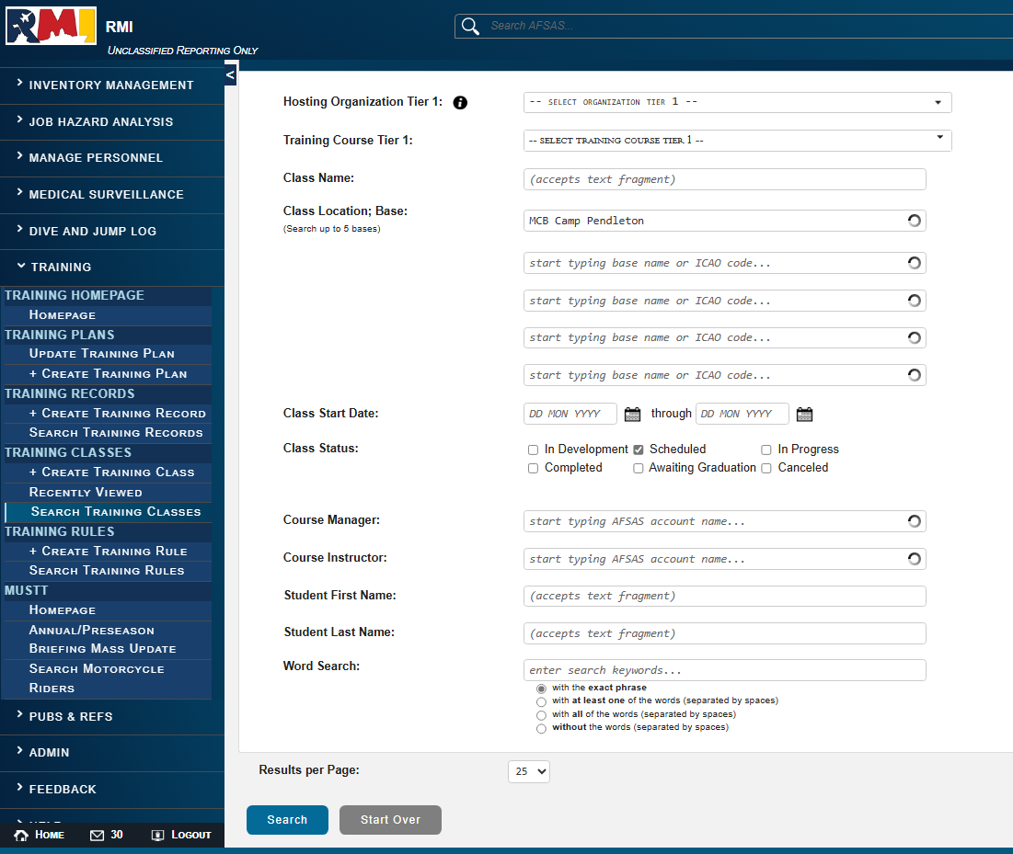
Type “MCB Camp Pendleton” in the “Class Location; Base” box.
This should pop up as a dropdown option.
Select “Scheduled” next to “Class Status”.
Click “Search”

Slide 4
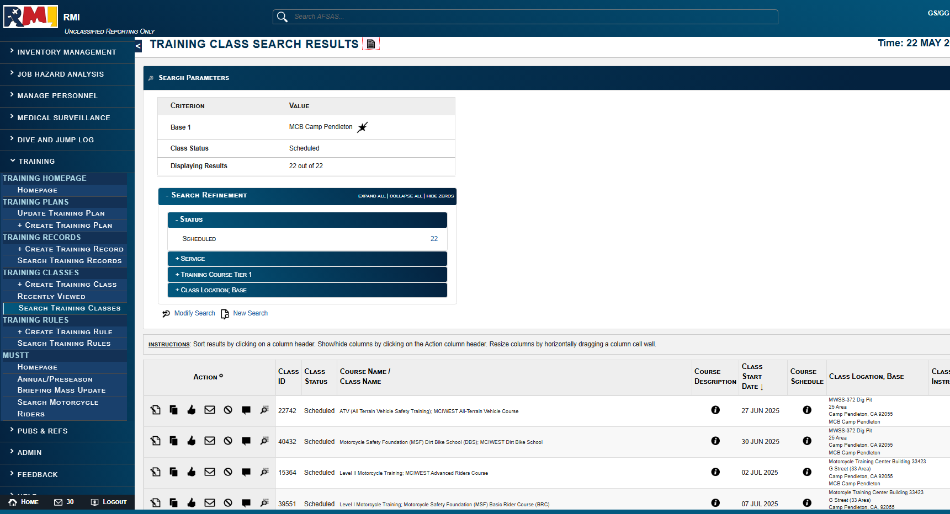
A list of all “Scheduled” classes offered at “MCB Camp Pendleton should populate.

Slide 5
Select a class you would like to enroll in and click on “ Class Data Viewer” to view details on the course.

Slide 6
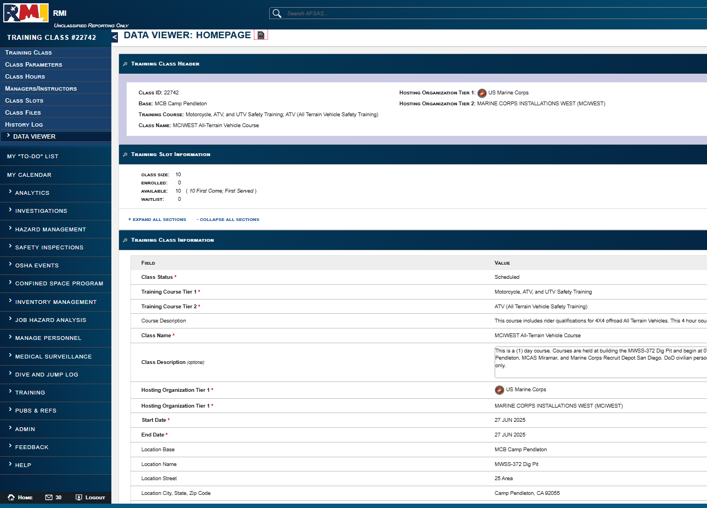
“Class Data Viewer” will provide details on the course to include;
-Class Size
-Available Seats
-Description
-Hosting Org
-Start & End Date
-Location

Slide 7
Select a class you would like to enroll in and click the “I Class Enrollment Request”.

Slide 8
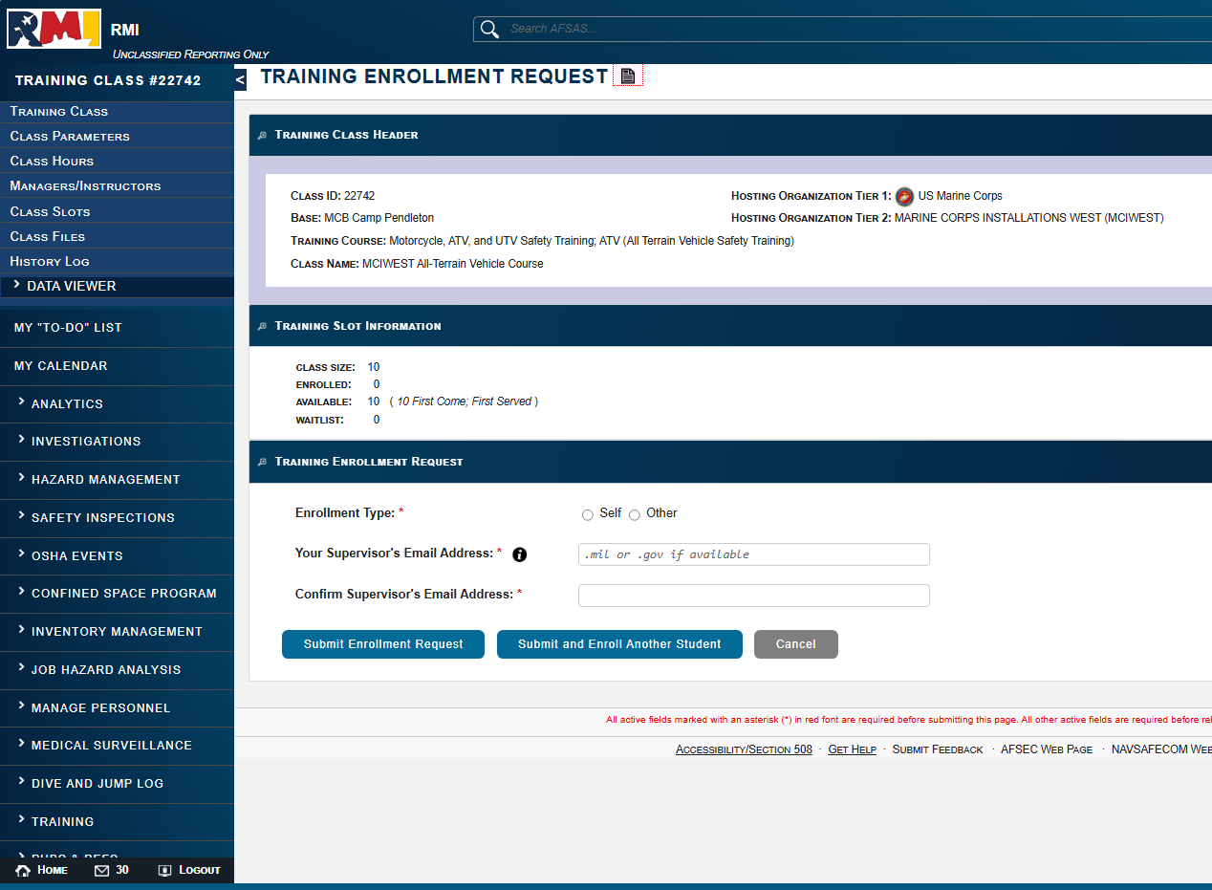
If the class is full, you can still enroll but will be put on the “Waitlist”.
Select whether you are enrolling “Self” or someone else “Other”.

Slide 9
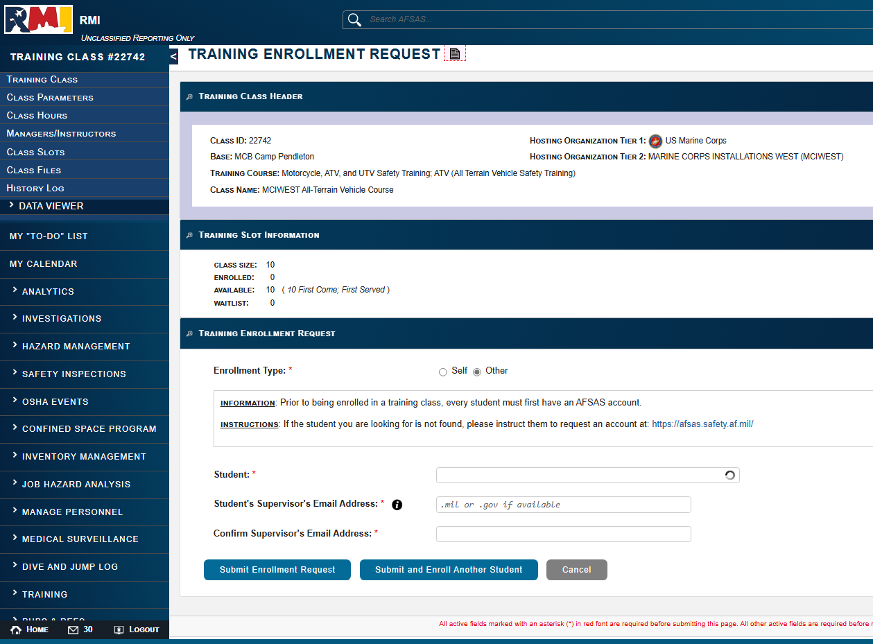
If you selected “Other”.
Start typing in the students last name, an RMI account exists, their name should populate in a list of recommended accounts.
If their name does not auto populate, this means they do NOT have an RMI account and need to create one.

Slide 10
Enter your Supervisor or MMP President’s full email.
Note: There is no auto suggestions for RMI accounts, and you must know and enter the entire email address.
Click “Submit Enrollment Request” or “Submit and Enroll Another Student”

Slide 11
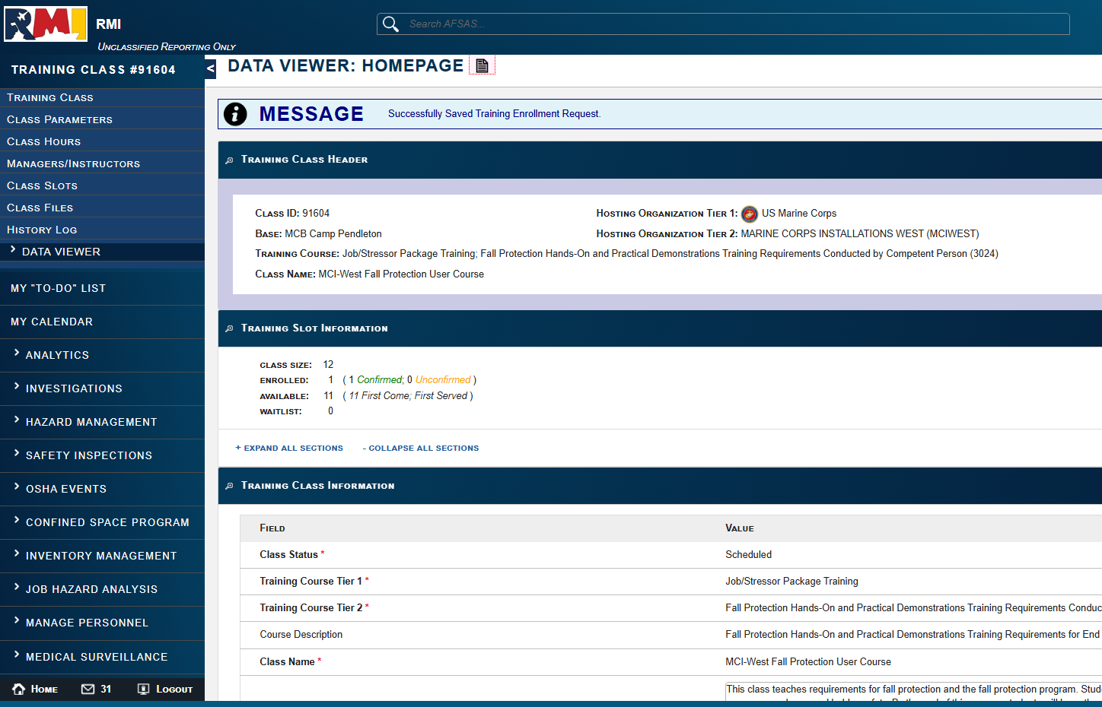
After submitting your request, you should see a message that says “Successfully Saved Training Enrollment Request”
The Training Slot Information will change, and your enrollment request will be assigned as one of the following;
-Confirmed
-Unconfirmed
-Waitlist

Slide 12
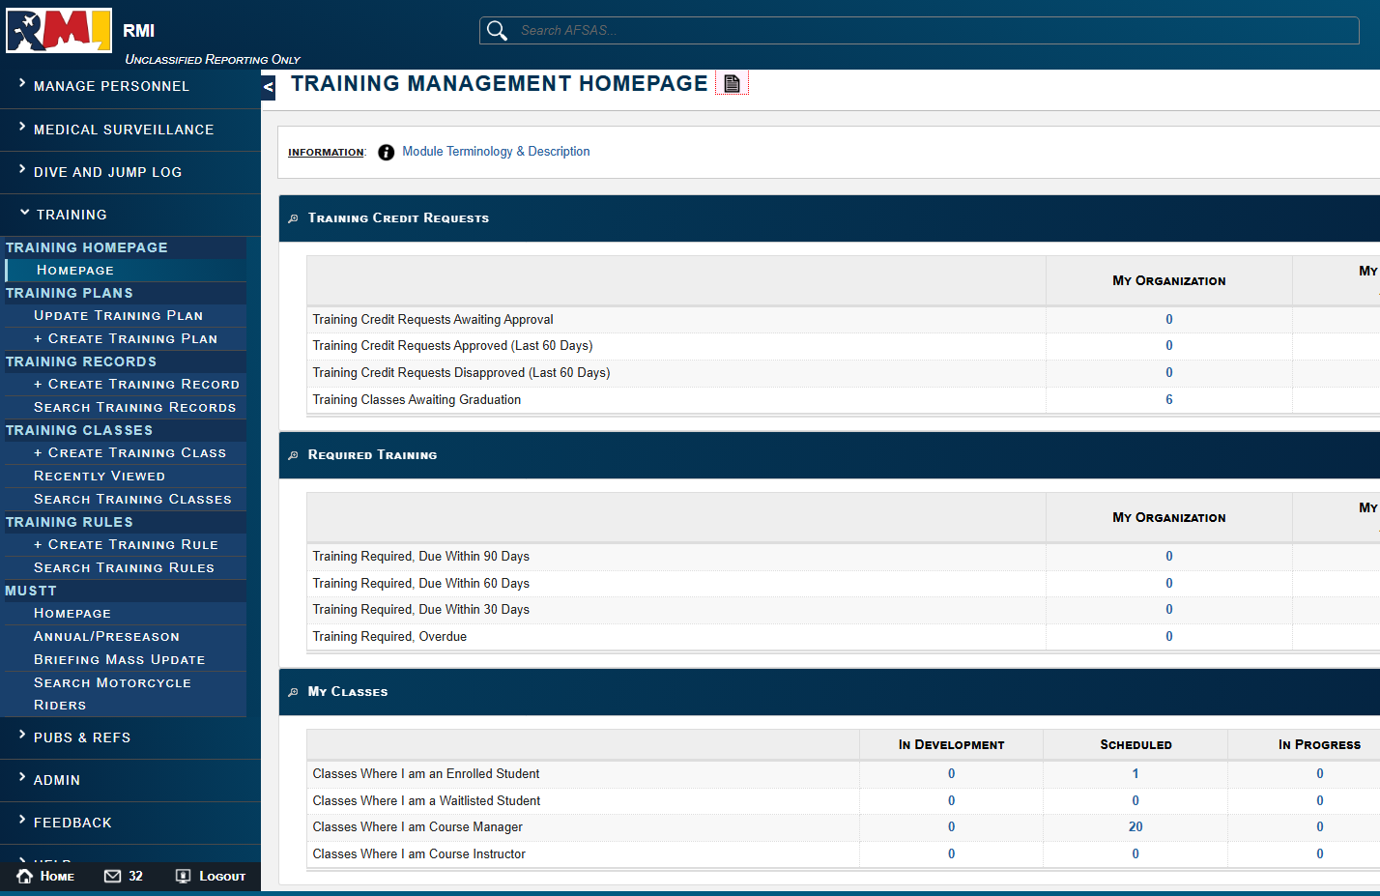
To check your enrollment status, click on the Training module again and select “Homepage”
Under “My Classes” you will see and click on the classes you are enrolled in or on the waitlist for.

